Slide 1
Geena Davis Institute | Impact Analysis
Team 1
Blake Abel, Yanjie Chen, Houjun Tang
Sponsor: Geena Davis Institute

Slide 2
Project Motivation
Project Goal:
Interpret the organic data and evaluate the impact of the Institute on the salience of gender in media
Create analytical strategies that can be interacted for future use.
Backgrounds:
GDI:
Founded in 2004 by Actor Geena Davis
Research-based organization working within the Entertainment and Media industry
Aim to create gender balance, foster inclusion and reduce negative stereotyping in family entertainment media.
Meltwater:
Media & Social Media Data Monitoring Platform
Provides raw data and analysis tools for organizations make informed decisions.

Slide 3
Data & Challenges
What data have you used? If you collected data, how did you do that?
The data we used is datasets from Meltwater, which contains different sources (News, Radio/TV Broadcasts, and Social Media). Each dataset includes detailed information about the source mentioning the Geena Davis Institute. Also we collected some data from Google Trends.
What challenges did you encounter working with data?
Data from specific time periods are missing: Social Media data was only collected from 2020 -2021 and Broadcast data is only available since 2016. Not much at 2004 when it was founded!
Some entries from the datasets are repetitive. A few columns are useless for our analytical purpose.
The amount of Google Trends dataset is relatively low.

Slide 4
Analysis and Techs behind
Main Analyses:
Trend and correlation analysis across multiple data sources, to show impact
Sentiment analysis, to evaluate positive/negative impact
Data Science Methods
Classification and anomaly detection were most useful to make complicated data easy to understand.
Dimensionality reduction
We performed diagnostic, individual review methods to investigate how the outlier data points occured when automated methods could not come up with a clearly human-understandable answer.
How did the choice of the analyses relate to your project goal?
We thought backward from our project goal and key questions to think about how best to analyze our data. So visualizing our analyses effectively was very important to us, as was incorporating data from not just news but also social media and broadcasting.
Notes:
Main Analyses:
We performed the trend and correlation analysis between GDI and Gender in General Media: we calculated the number of times the GDI and gender parity were mentioned together over time.
We also correlated data from Google Trends with dates the GDI publishes articles to show how the two changed together.
Next, we used the sentiment data from meltwater to show how the public opinion of the GDI has changed over time.

Slide 5
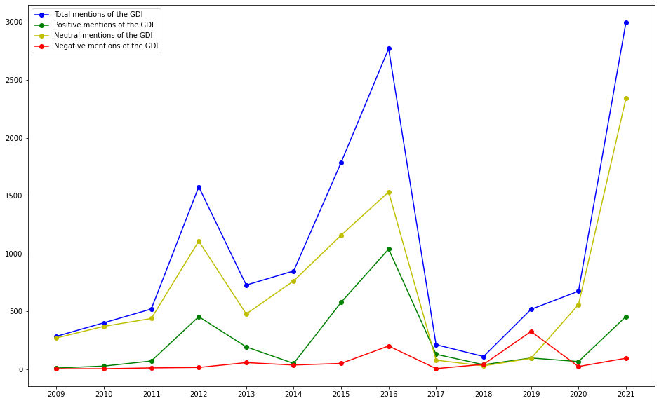
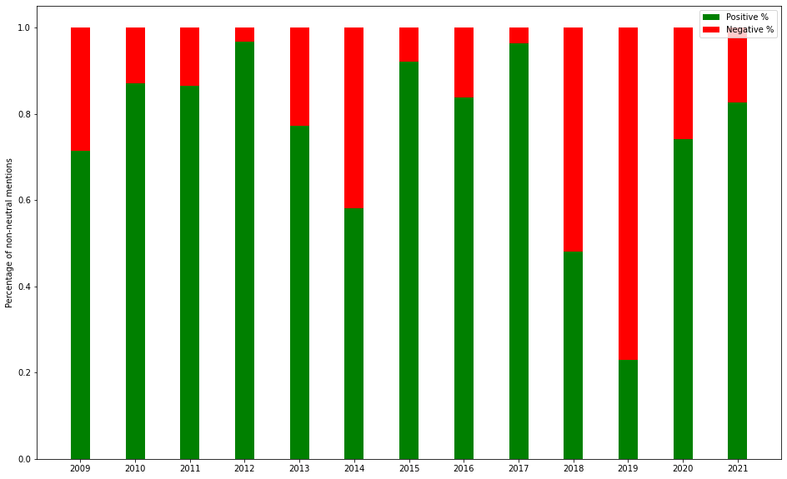
Analysis Results
4645 news articles written
Negative sentiment spike:
Geena Davis (actor) interview aired on many radio broadcast channels that was incorrectly set as negative due to her passionately speaking about some of the problems with gender representation in media with agressive wording.

Slide 6
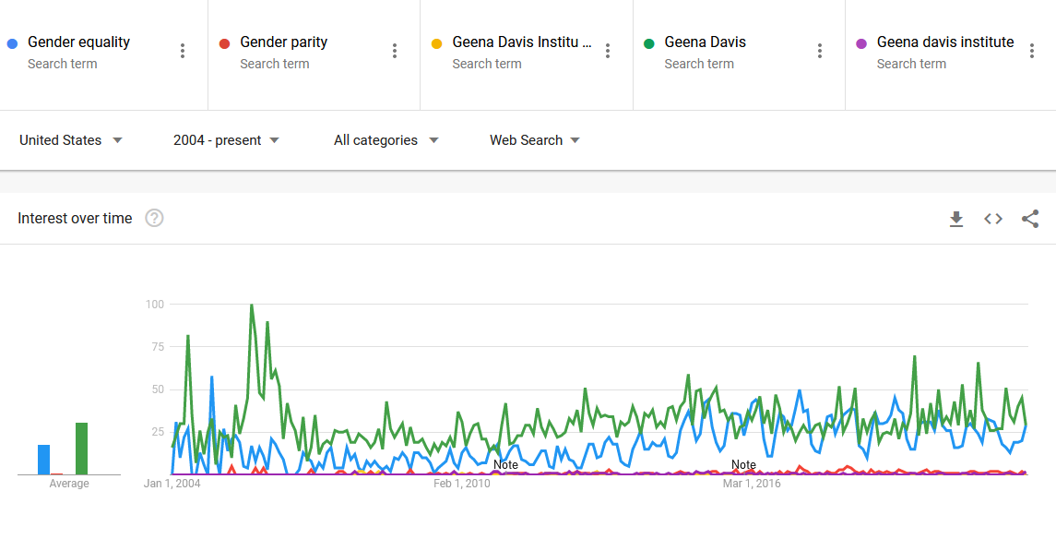
Results Continued
The overall news’s opinion toward GDI is neutral/positive from 2009 to now, with most of the time positive sentiments significantly higher than negative sentiments.
Google search peaks when new research published, but not enough data on the GDI itself to directly compare to gender equality as a whole.
Also, searches for both the GDI and gender equality increase over time!
Notes:
Netrual, which is not surprising since news are aimed to stay objective.
Whenever there are new researchs published by GDI, there is a peek in the search of gender parity, Geena Davis.

Slide 7
Conclusion and Future works
Conclusion:
The GDI is having a positive correlation with gender paparity in media.
With the number of articles that have mentioned GDI and their overall sentiments toward it, the GDI will be increasingly influential to the entertaining industry.
Future works:
Possible future work will be creating an automated methods for our client to have an impact analysis. This may include building a website GDI staff can operate to interactively explore the data themselves, or could automatically generate reports based on the backend data.
The methods we used to collect data off of Meltwater can be easily replicated to gather additional backend data, and those data can be easily cleaned and visualized with our code.

